Slide 1


A CENTER FOR INTER-DISCIPLINARY RESEARCH 2022-23
TITLE
SMART DUSTBIN
SUPERVISED BY
B V S NITHIN, G V MAHATI
GOKARAJU RANGARAJU
INSTITUTE OF ENGINEERING AND TECHNOLOGY AUTONOMOUS

Slide 2
Advanced Academic Center
( A Center For Inter-Disciplinary Research )
This is to certify that the project titled
SMART DUSTBIN
is a bonafide work carried out by the following students in partial fulfillment of the requirements for Advanced Academic Center intern, submitted to the chair, AAC during the academic year 2022-23.
RO
ENDRAPU KRANTHI RAJ | 21241A04E8 | ECE
V DINESH CHANDRA | 21241A0558 | CSE
P MAMATHA | 21241A051D | CSE
GNANA SRAVYA KADALI | 21241A1224 | IT
KRUSHNA VARSHITHA | 21241A05N0 | CSE

Slide 3
This work was not submitted or published earlier for any study
Ms. G V Mahati Dr.B.R.K.Redd Dr.G.Ramesh
Mr. B. V. S Nithin
Project Supervisor Program Coordinator Associate Dean,AAC

Slide 4
ACKNOWLEDGEMENTS
We express our deep sense of gratitude to our respected Director, Gokaraju Rangaraju Institute of Engineering and Technology, for the valuable guidance and for permitting us to carry out this project.
With immense pleasure, we extend our appreciation to our respected Principal, for permitting us to carry out this project.
We are thankful to the Associate Dean, Advanced Academic Centre, for providing us an appropriate environment required for the project completion.
We are grateful to our project supervisor who spared valuable time to influence us with their novel insights.
We are indebted to all the above mentioned people without whom we would not have concluded the project.

Slide 5
TABLE OF CONTENTS
1. ABSTRACT………………………………………….6
2. INTRODUCTION…………………………………...6
3. PROJECT WORKFLOW…………………………….7
4. HARDWARE USED………………………………….7--10
    ESP 32
    ULTRASONIC SENSOR
    SOIL MOISTURE
4. SERVO MOTOR
5. SOTWARE USED…………………………………..11
    ARDUINO IDE
    ARDUINO IOT CLOUD
6. CODE………………………………………………..12--15
7. CODE WORKING VIDEO. ………………………..16
8. CIRCUIT CONNECION IN THINKER CAD……..16
9. CONCLUSION……………………………………...1
10. FUTURE DEVELOPMENTS ……………………....17

Slide 6
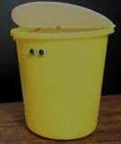
ABSTRACT
CLEAN INDIA GREEN INDIA is what we hear most these days, but most of the people are not following the rules and not using dustbins in a proper way due to which we face the problem of separating wet waste and dry waste
The main objective of this project is to design a smart dustbin which will help in keeping our environment clean and also eco friendly. We are using soil moisture sensor to know the moisture of the waste by which we can separate the waste and then store it differently.
Our system is built using ESP32, Ultrasonic sensor , servo motor and soil moisture sensor.
INTRODUCTION
Dustbin is the storage container used for disposing waste by each and every person in the world. The main thing they look in their surroundings for disposing waste is the dustbin. Smart Dustbin is just a normal bin where everyone can dispose waste but integration of some hardware components is done for more efficient use of it. Smart Dustbin is integrated with some hardware components such as ESP32, Servo Motor, Ultrasonic sensors and Soil sensors. These components help in help in separating the dry and wet waste which will in turn help an eco-friendly environment.
We have used the AURDIONE IDE for the software development.
This equipment will help in separating the waste and storing it differently which can help us in fast biodegrading and recycling of waste.

Slide 7
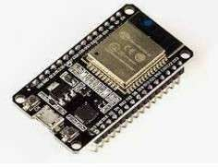
PROJECT WORK FLOW
ESP32 has been used as the base of the project, to give commands and receive signals.
A person standing within 30cm radius of the dustbin is observed by the ultrasonic sensor and a command is passed to the ESP32, from ESP32 a command is send to servo motor to rotate the cap of the bin, when the person puts in the waste in the bin and then the moisture level is checked by the soil-moisture sensor and the waste is categorized as dry or wet based on the moisture level and is separated.
There is app and website is available which shows the moisture level of the waste and weather the waste is wet or dry.
HARDWARE USED
ESP32
ESP32 is a low-cost System on Chip (SoC) Microcontroller from Espressif Systems, the developers of the famous ESP8266 SoC. It is a successor to ESP8266 SoC and comes in both single-core and dual-core variations of the Tensilica’s 32-bit Xtensa LX6 Microprocessor with integrated Wi-Fi and Bluetooth.
The good thing about ESP32, like ESP8266 is its integrated RF components like Power Amplifier, Low-Noise Receive Amplifier, Antenna Switch, Filters and RF Balun. This makes designing hardware around ESP32 very easy as you require very few external components.
ESP32

Slide 8
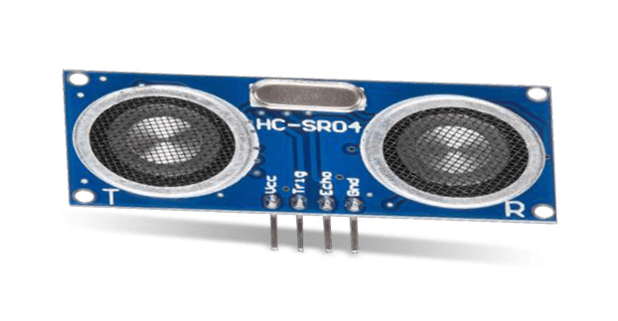
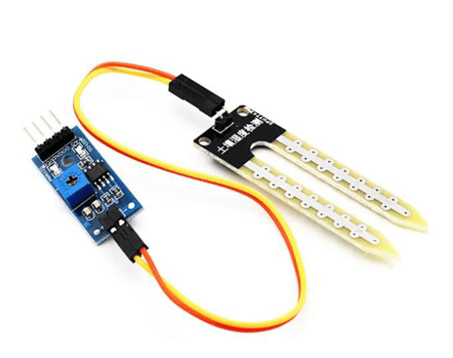
ULTRASONIC SENSOR
An ultrasonic sensor is an electronic device that measures the distance of a target object by emitting ultrasonic sound waves, and converts the reflected sound into an electrical signal. Ultrasonic waves travel faster than the speed of audible sound (i.e. the sound that humans can hear). Ultrasonic sensors have two main components: the transmitter (which emits the sound using piezoelectric crystals) and the receiver (which encounters the sound after it has travelled to and from the target). In order to calculate the distance between the sensor and the object, the sensor measures the time it takes between the emission of the sound by the transmitter to its contact with the receiver. The formula for this calculation is D = ½ T x C (where D is the distance, T is the time, and C is the speed of sound ~ 343 meters/second). Ultrasonic sensors are also used as level sensors to detect, monitor, and regulate liquid levels in closed containers (such as vats in chemical factories). Most notably, ultrasonic technology has enabled the medical industry to produce images of internal organs, identify tumors, and ensure the health of babies in the womb
ULTRASONIC
SOIL MOISTURE
Soil moisture sensors measure the volumetric water content in soil. Since the direct gravimetric measurement of free soil moisture requires removing, drying, and weighing of a sample, soil moisture sensors measure the volumetric water content indirectly by using some other property of the soil, such as electrical resistance, dielectric constant, or interaction with neutrons, as a proxy for the moisture content.
The relation between the measured property and soil moisture must be calibrated and may vary depending on environmental factors such as soil type, temperature, or electric conductivity. Reflected microwave radiation is affected by the soil moisture and is used for remote sensing in hydrology and agriculture. Portable probe instruments can be used by farmers or gardeners.
Soil moisture sensors typically refer to sensors that estimate volumetric water content. This has been used in our projects to separate wet waste and dry waste.
SOIL MOISTURE

Slide 9
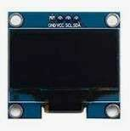
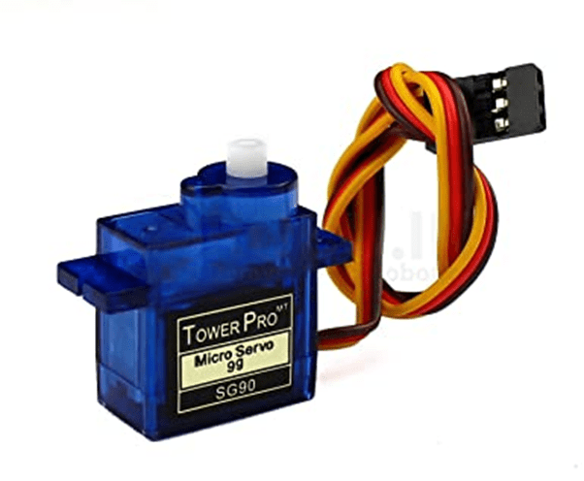
OLED
An organic light-emitting diode (OLED or organic LED), also known as organic electroluminescent (organic EL) diode, is a light-emitting diode (LED) in which the emissive electroluminescent layer is a film of organic compound that emits light in response to an electric current. This organic layer is situated between two electrodes; typically, at least one of these electrodes is transparent. OLEDs are used to create digital displays in devices such as television screens, computer monitors, and portable systems such as smart phones and handheld game consoles. A major area of research is the development of white OLED devices for use in solid-state lighting applications. This has been used for displaying information of the waste dumped like if it is wet or dry, weight of the wasted put in etc.
OLED
SERVO MOTOR
A servo motor is a rotary actuator that allows for precise control of angular position. It consists of a motor coupled to a sensor for position feedback. It also requires a servo drive to complete the system. The drive uses the feedback sensor to precisely control the rotary position of the motor.
SERVO MOTOR

Slide 10
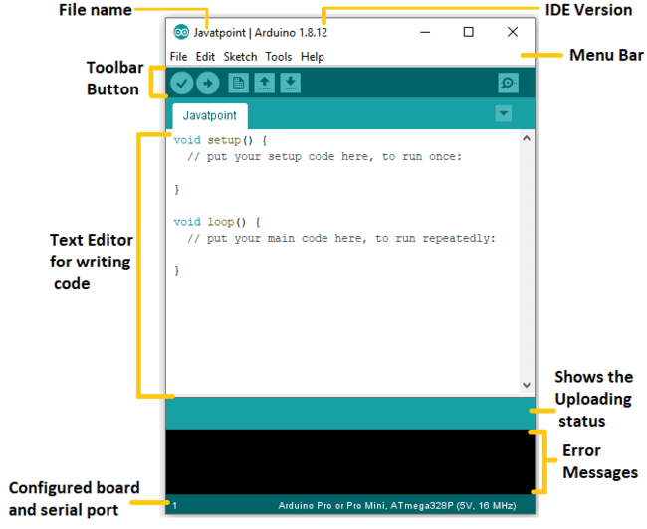

SOFTWARE USED
ARDUINO IDE
The Arduino Integrated Development Environment (IDE) is a cross-platform application (for Windows, macOS, Linux) that is written in functions from C and C++. It is used to write and upload programs to Arduino compatible boards. The Arduino board is connected to a computer via USB, where it connects with the Arduino development environment (IDE). The user writes the Arduino code in the IDE, then uploads it to the microcontroller which executes the code, interacting with inputs and outputs such as sensors, motors, and lights. Arduino serial monitor can be opened by clicking on the magnifying glass icon on the upper right side of the IDE or under tools. The serial monitor is used mainly for interacting with the Arduino board using the computer and is a great tool for real-time monitoring and debugging.

Slide 11
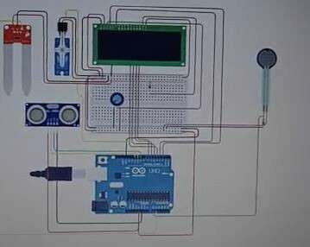
Wi-Fi Module- ESP32:
CODE
#include <LiquidCrystal.h>
#include<Servo.h>
#define moisturePin A1
LiquidCrystal lcd = LiquidCrystal(2, 3, 4, 5, 6, 7); Servo servo1;
const int trigPin = 10;
const int echoPin = 9;

Slide 12
float duration, distance;
int points; int force = 0;
float weight = 0; float moisture = 0;
void setup()
{
lcd.begin(16, 2);
// For LCD Display
pinMode(A0, INPUT); pinMode(trigPin, OUTPUT); pinMode(echoPin, INPUT); servo1.attach(11); Serial.begin(9600);
}
void loop()
{
digitalWrite(trigPin, LOW); delayMicroseconds(2); digitalWrite(trigPin, HIGH);

Slide 13
delayMicroseconds(10);
digitalWrite(trigPin, LOW); duration = pulseIn(echoPin, HIGH); distance = (duration*.0343)/2;
// For Serial Monitor
Serial.print("Distance: "); Serial.print(distance); Serial.println("cm");
// for Servos
if(distance <= 30)
{
servo1.write(90); delay(7000);
moisture = analogRead(moisturePin); if(moisture >=30)
{ Serial.print("Wet Waste Dumped");
//Actully Servo2 is needed
}
else

Slide 14
{ Serial.print("Dry Waste Dumped");
//Actully Servo2 is needed
}
//Weight Calculation force = analogRead(A0);
weight = force/9.8; points = weight/10;
// for LCD Display lcd.setCursor(0,0); lcd.print("Weight = "); lcd.setCursor(9,0); lcd.print(weight); lcd.setCursor(14,0); lcd.print("kg"); lcd.setCursor(0,1); lcd.print("Point = "); lcd.setCursor(7,1); lcd.print(points);
delay(30000);//30 Seconds dealy
servo1.write(0);
}
else

Slide 15
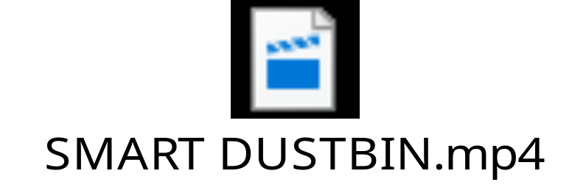
{
servo1.write(0); delay(10);
}
}
CODE WORKING VIDEO

Slide 16
CONCLUSION
Here we are going to make an evolution change toward cleanliness. Smart dustbins are better addition for traditional garbage dustbin. It is equipped with smart devices like sensors, ESP32 etc. Lid of the dustbin will automatically open when an object comes near to the dustbin and after certain time period it will close automatically it will help toward health and hygiene and the smart dustbin will also help in reducing the task of separating wet and dry waste, if these are placed in places like canteens and malls etc. people will ensure to put the waste in the dustbin and it will later help in biodegradation and recycling.
FUTURE DEVELOPMENTS
Improving the efficiency of waste segregation.
Including of points system to increase interest in people to use the dustbin.
Creating the bin in a more useful way.
Promoting awareness among people to use dustbin.
Increase the number of bin available for the use.

